Slide 1
Metrology Automation Lunch & Learn Metrology.NET® ISO/IEC 17025 Uncertainties
Michael L. Schwartz

Slide 2
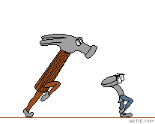
Learning Objectives
OOP (Object Oriented Programming) in VB.NET
Measurement Uncertainties in the Drivers
Resolution & Repeatability
Formatting Excel Spreadsheets for Metrology.NET®
Uploading and Using Excel Spreadsheets

Slide 3
About Cal Lab Solutions
Veteran owned business, ex-military metrologist
Core business is software
Metrology consulting
Efficiencies through automation
Turn-key system
Focus on finding the right solution for the customer
Created Metrology.NET® in 2015
World’s largest MET/CAL® procedure library
PS-Cal® power sensor calibration solution - Now Tegam’s Product
C# web-based asset management system
Acquired Cal Lab Magazine in 2011

Slide 4
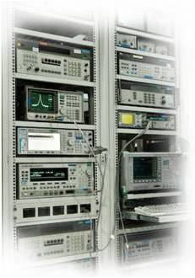
Business is about Efficiency?
Better
Cheaper
Faster
That doesn’t mean less accurate

Slide 5
Problem Statement
Automation software uncertainties and a lab’s accredited uncertainties don’t match.
How does Metrology.NET® calculate uncertainties?

Slide 6
Example Overview
We are going to look at a Fluke 5720A’s Uncertainties for Test Process.Source.Voltage.DC:
First in the Driver
Then adding Resolution and Repeatability
Then a Spreadsheet for the Fluke 5720A:
The Metrology.NET tab
Scope of Accreditation Uncertainties
Manual Calibration Uncertainties.
The Metrology.NET tab
Use Metrology.NET Uncertainties with any software

Slide 7
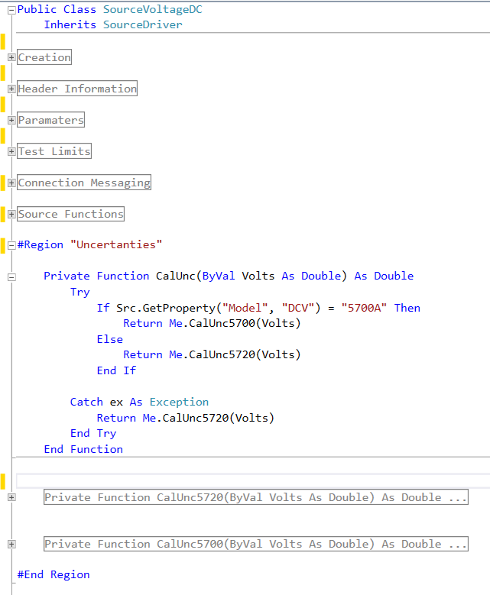
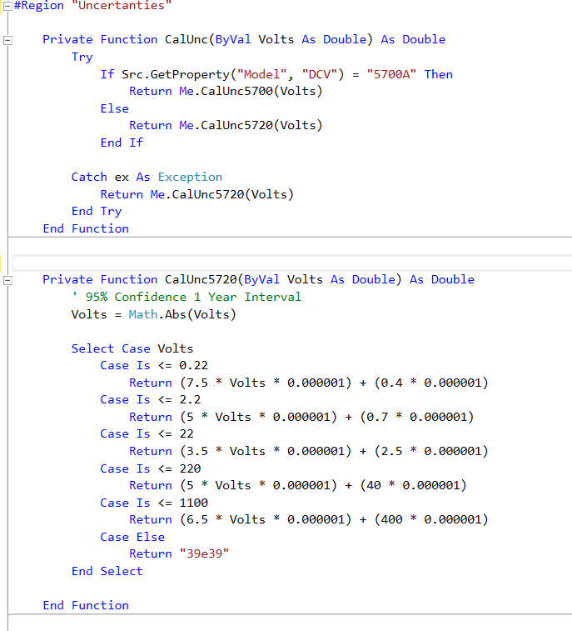
Code Review
Fluke 5720A Measurement Uncertainties

Slide 8
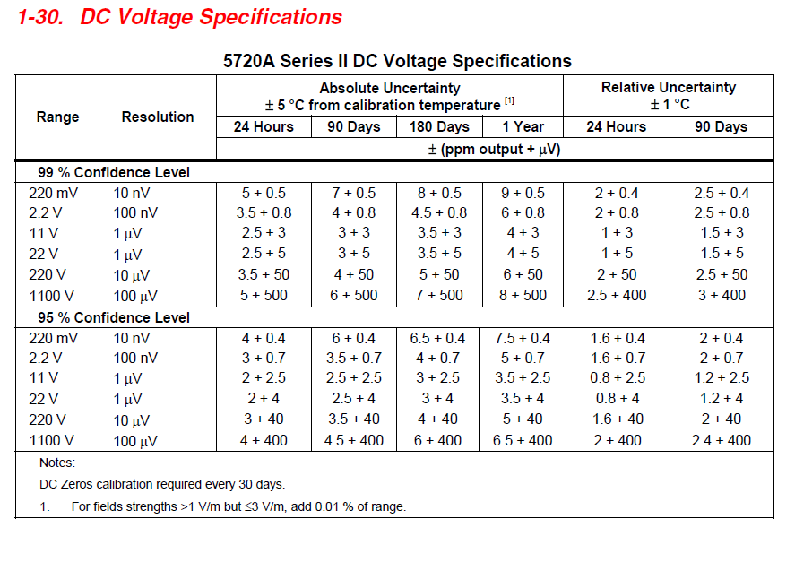
Code Review
Fluke 5720A Measurement Uncertainties

Slide 9
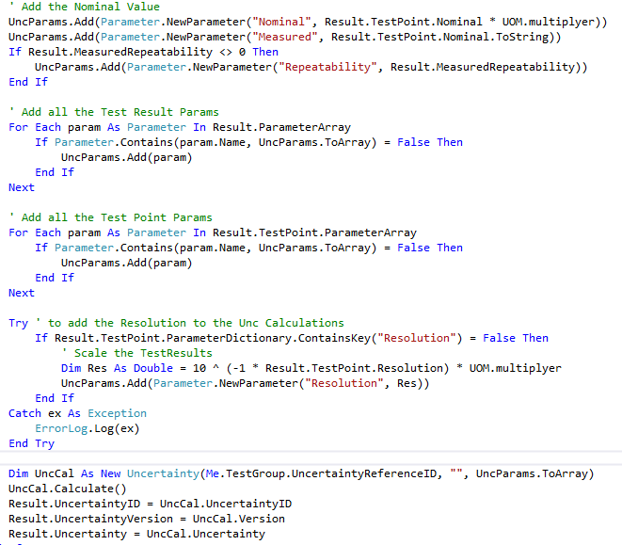
Code Review
Test Process adds Resolution & Repeatability

Slide 10
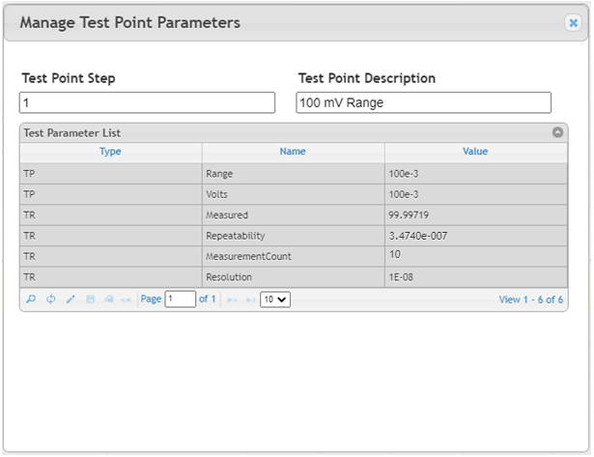
Code Review
User Interface Shows the Test Result Values

Slide 11
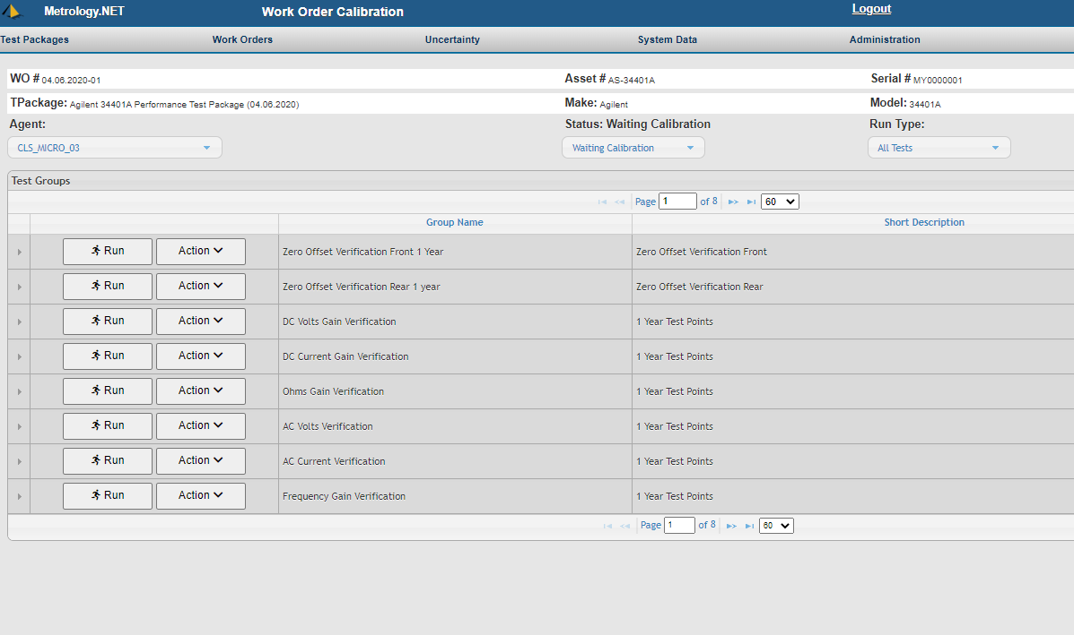
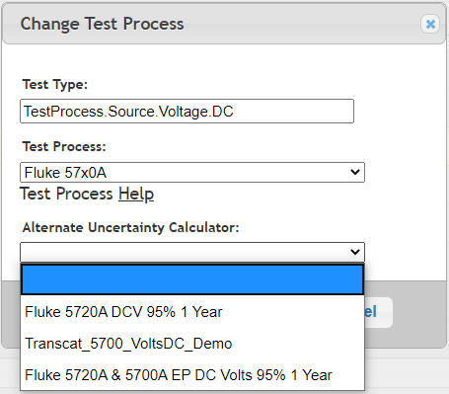
Alternate Uncertainty Calc
You can use an Alternate Uncertainty Calculator

Slide 12
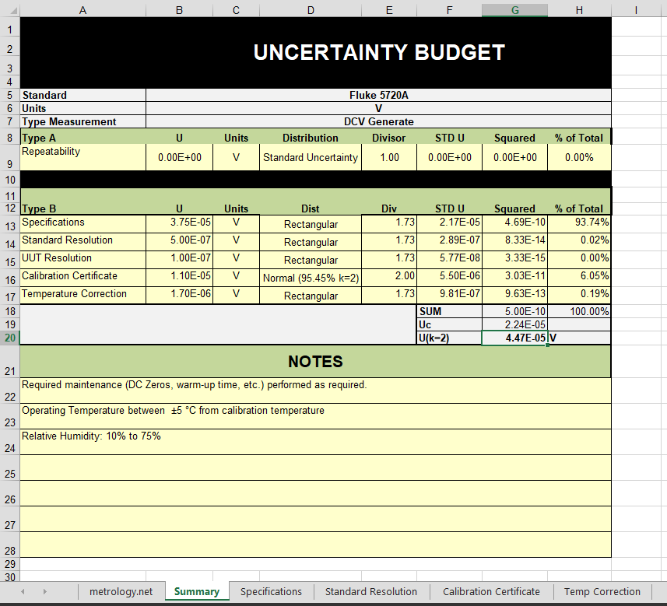
Alternate Uncertainty Calc
You can use an Alternate Uncertainty Calculator

Slide 13
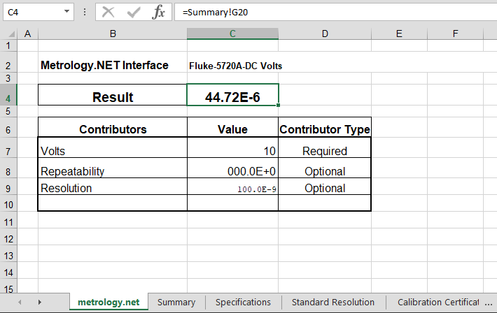
Alternate Uncertainty Calc
You can use an Alternate Uncertainty Calculator

Slide 14
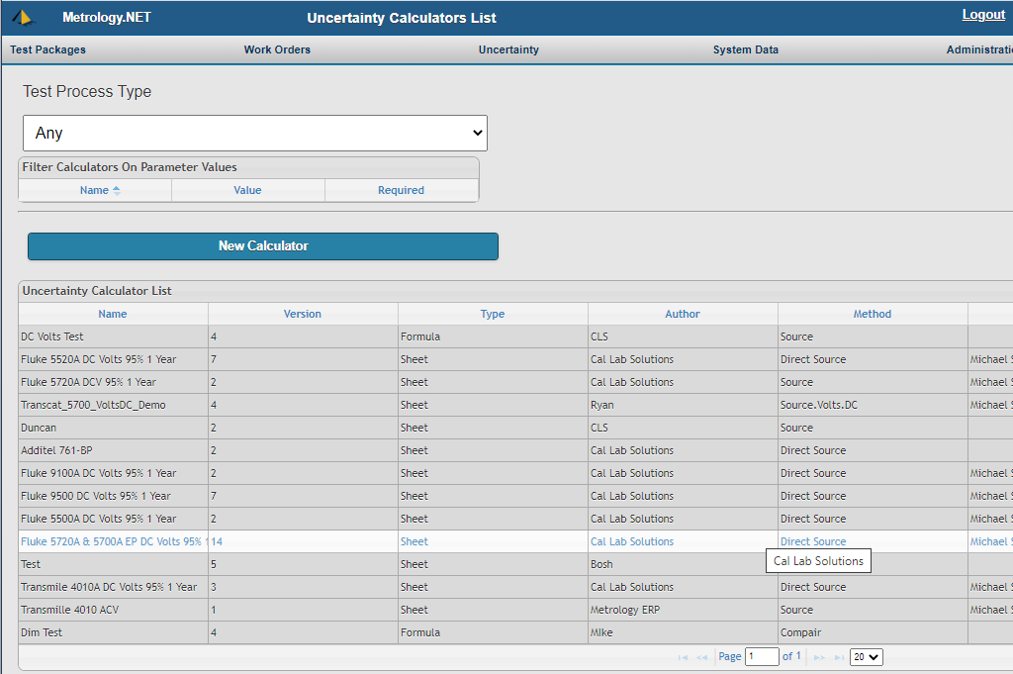
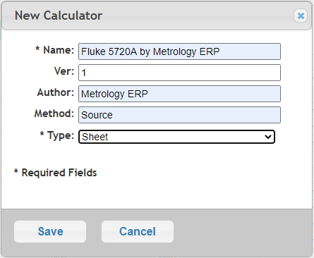
Alternate Uncertainty Calc
Upload an Uncertainty calculator

Slide 15
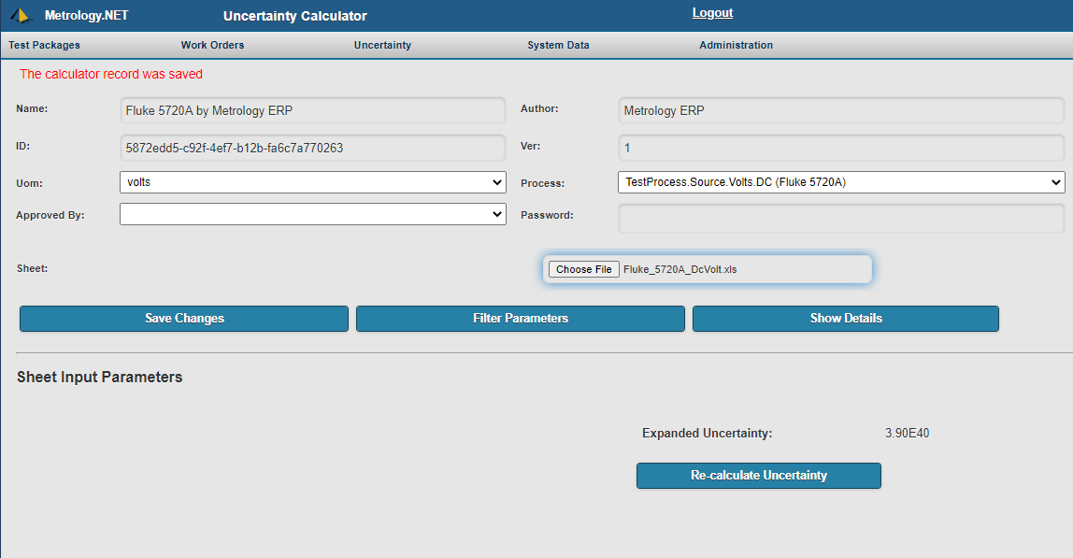
Alternate Uncertainty Calc
Upload an Uncertainty calculator

Slide 16
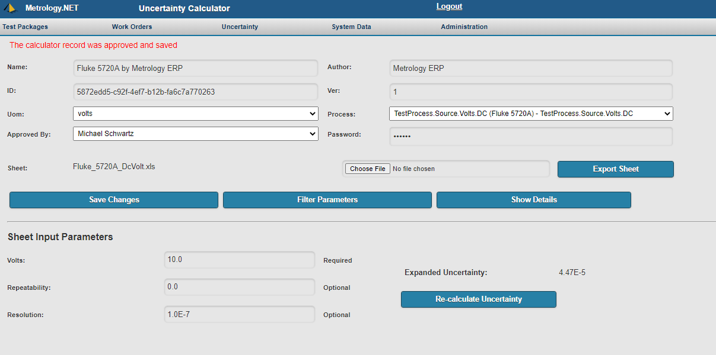
Alternate Uncertainty Calc
Upload an Uncertainty calculator

Slide 17
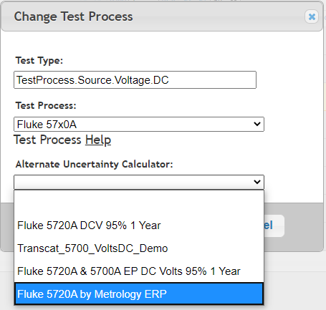
Alternate Uncertainty Calc
You can use an Alternate Uncertainty Calculator

Slide 18
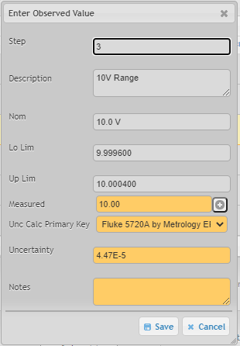
Manual Calibration Unc
The Uncertainty Calculator is also Available for Manual Calibration

Slide 19
Homework Assignment
Quality Magazine – “How to Add Dynamic Measurement Uncertainties to Any Metrology Software”
https://digital.bnpmedia.com/publication/?i=273926&p=36
or
https://www.callabsolutions.com/category/papers-articles/
Cal Lab Magazine – “Using Metrology.NET to Calculate ISO/IEC 17025 Uncertainties for Fluke MET/CAL”
https://www.callabmag.com/using-metrology-net-to-calculate-isoiec-17025-uncertainties-for-fluke-metcal/
Or
https://www.metrology.net/papers/

Slide 20
Learning Objectives
OOP (Object Oriented Programming) in VB.NET
Measurement Uncertainties in the Drivers
Resolution & Repeatability
Formatting Excel Spreadsheets for Metrology.NET®
Uploading and Using Excel Spreadsheets

Slide 21
Questions? / Comments
Michael L. Schwartz
Cal Lab Solutions
mschwartz@callabsolutions.com

