Slide 1
Metrology Automation Lunch & Learn Metrology.NET® Building Drivers with Reusable
Michael L. Schwartz

Slide 2
Learning Objectives
OOP (Object Oriented Programming) in VB.NET
New Reusable DLL
.NET Reflection
Properties and Attributes
Testing & Running Metrology.NET

Slide 3
About Cal Lab Solutions
Veteran owned business, ex-military metrologist
Core business is software
Metrology consulting
Efficiencies through automation
Turn-key system
Focus on finding the right solution for the customer
Created Metrology.NET® in 2015
World’s largest MET/CAL® procedure library
PS-Cal® power sensor calibration solution - Now Tegam’s Product
C# web-based asset management system
Acquired Cal Lab Magazine in 2011

Slide 4
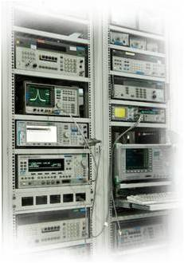
Business is about Efficiency?
Better
Cheaper
Faster
That doesn’t mean less accurate

Slide 5
Problem Statement
Every line of code you write, is a line of code you have to debug and support!
As much as 80% of the cost of software is in support and maintains costs.
We needed to make some changes to driver in Metrology.NET and didn’t want to create more code.

Slide 6
Update Requirements
Shorts & Opens are more accurate than the calibrators. We needed to add the option to use a Short / Open in the following Test Process: Source.Capacitance
Source.Current.DC Source.Resistance Source.Voltage.DC In the Following Drivers:
Fluke 55xxA
Fluke 57xxA
Transmille 4010A
Run Time Configuration
We added a new Attribute “RunTimeConfigParameter”
Any Property in a Test Process with this attribute is now configurable at runtime
Created two new Reusable Test Process
TestProcessTypicalSource TestProcessTypicalMeasure

Slide 7
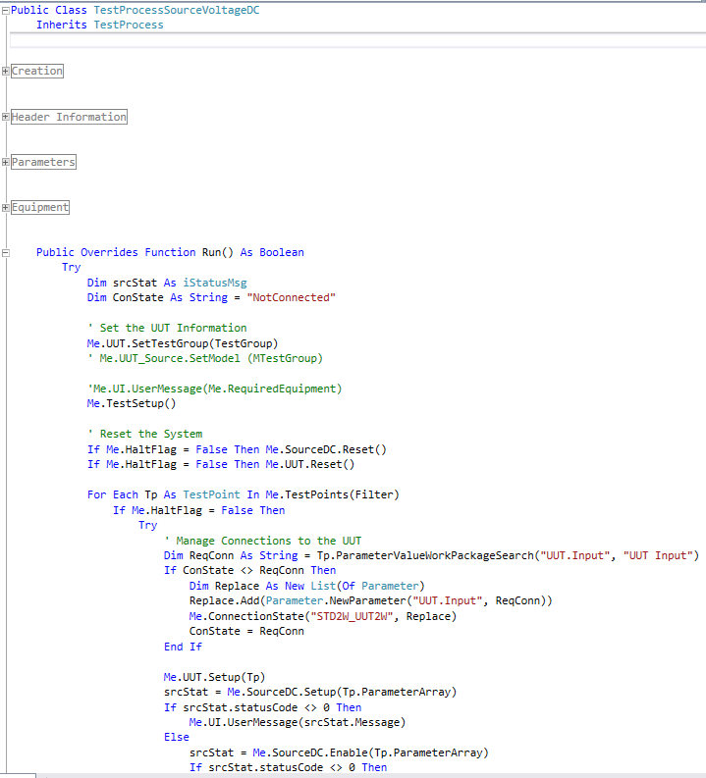
Code Review
Old Code
The Fluke 55xx Source.Voltage.DC needed to have the option testing zero volts DC with a short or the calibrator.
This would have added ~200 lines of code making the total code ~500 lines of code.
Then Source.Capacitance, Source.Current.DC, Source.Resistance in the 57xx & 4010 would also need an additional 200 lines of code for a total of ~2400 additional lines of code.
Debugging 2400 lines of code is a lot of work.

Slide 8
High Level Code Change
What is common with all the code is the metrology process.
So… Lets make that code Reusable/
For Each TestPoint
Check the Connection
Calibrate
Setup the Reference Standard
Setup the Unit Under Test
Enable the Output
Make a Measurement Disable the Output Next
By attaching the TestPoint(s) to the Connection Now we Can
For Each Connection
Make Connection
For Each TestPoint (In Connection)
Calibrate
Next
Next

Slide 9
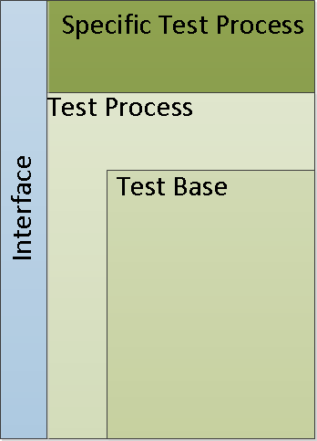
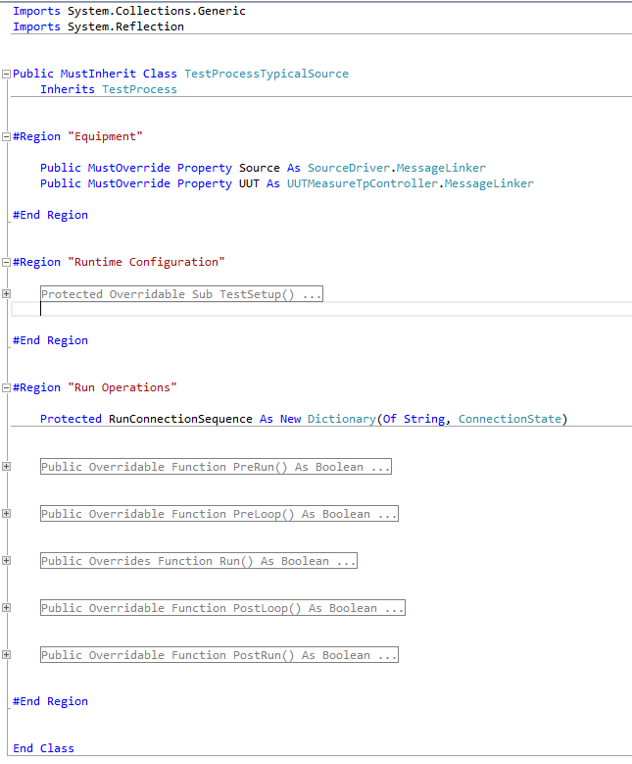
Code Review
Creating a Reusable / Generic Class Decrease code by as much a 1/3
Reusable

Slide 10
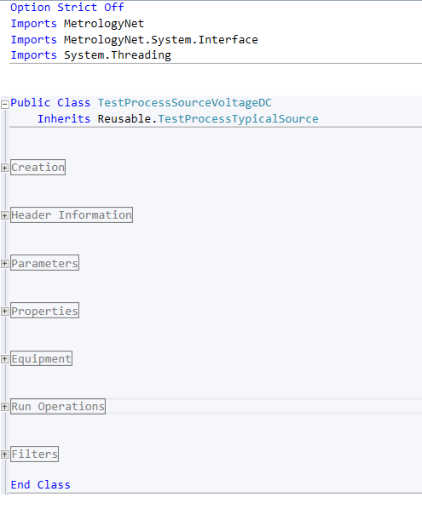
Code Review
Test Process will Inherit Reusable

Slide 11
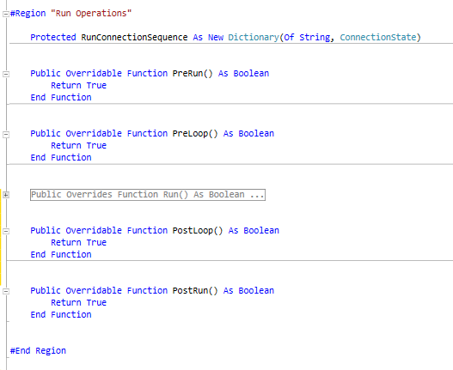
Code Review
Test Process will Inherit Reusable

Slide 12
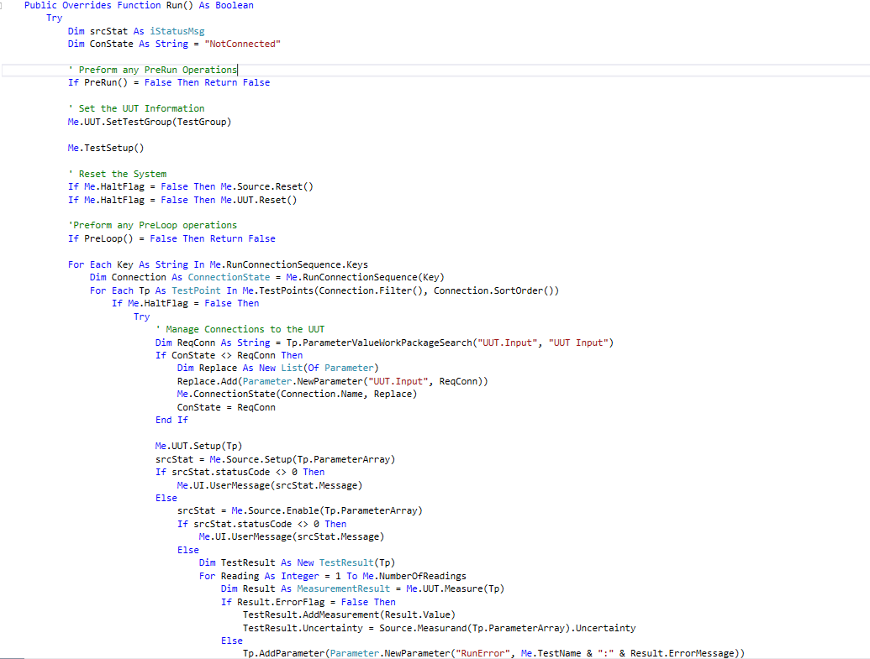
Code Review
The Run Function Call Becomes Standard

Slide 13
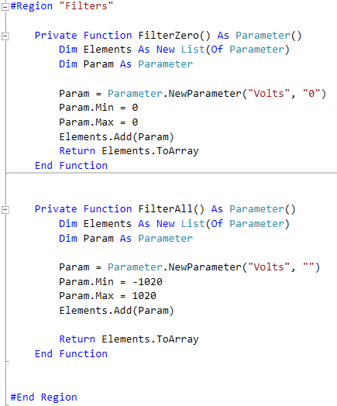
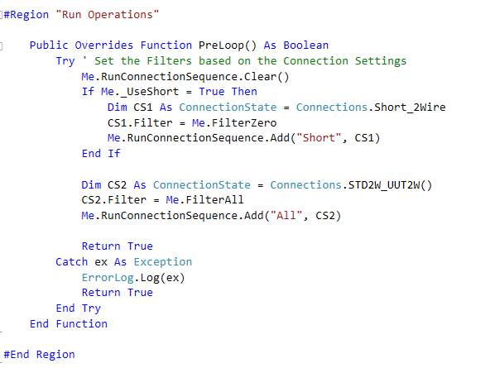
Connection Groups
The Run Function Call Becomes Standard

Slide 14
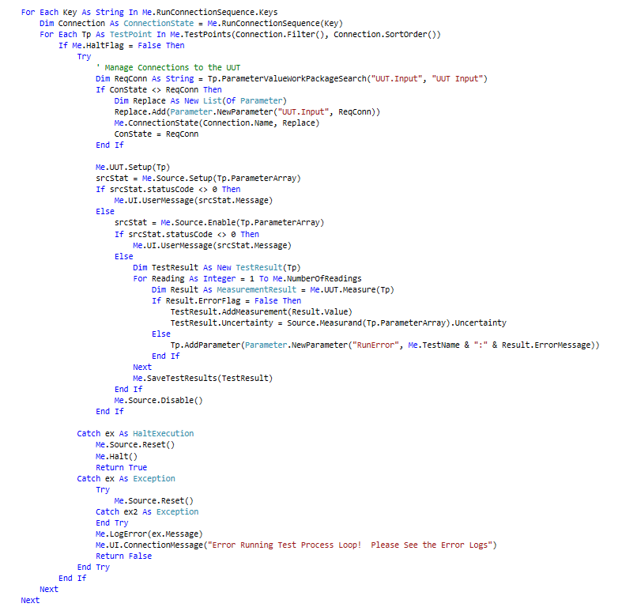
Code Review

Slide 15
Run Time Configuration
The Run Function Call Becomes Standard

Slide 16
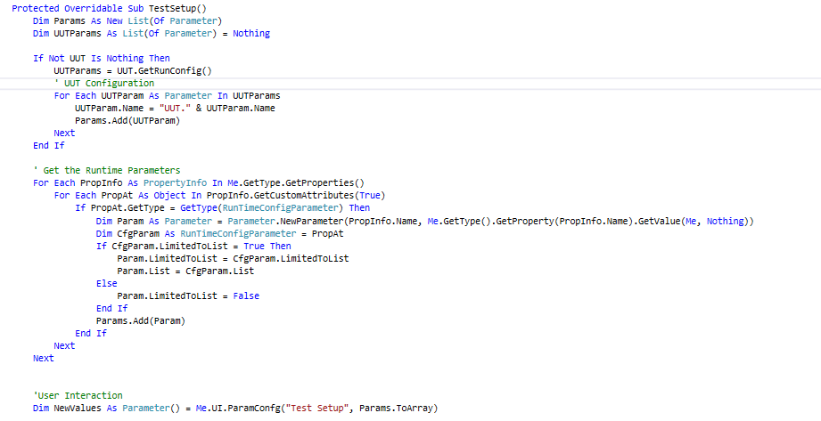
Run Time Configuration

Slide 17
Run Time Configuration
The TestProcess TestSetup Function will look for RunTimeConfigParameter and allow the operator to set that property at the start of the Run Process

Slide 18
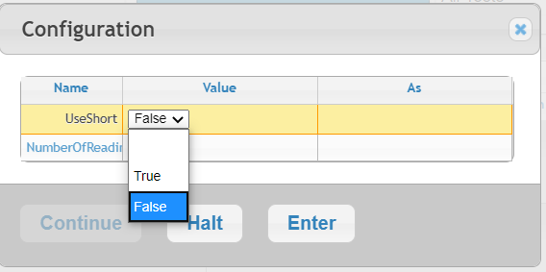
Run Time Configuration
Run Time Configuration on the UI.

Slide 19
Learning Objectives
OOP (Object Oriented Programming) in VB.NET
New Reusable DLL
.NET Reflection
Properties and Attributes
Testing & Running Metrology.NET

Slide 20
Questions? / Comments
Michael L. Schwartz
Cal Lab Solutions
mschwartz@callabsolutions.com

