Slide 1
Metrology Automation Lunch & Learn Metrology.NET® Testing Environment
Michael L. Schwartz

Slide 2
Learning Objectives
OOP (Object Oriented Programming) in VB.NET
Metrology.NET Driver Structure
Testing Threaded Applications
Setting up a testing solution in Visual Studio

Slide 3
About Cal Lab Solutions
Veteran owned business, ex-military metrologist
Core business is software
Metrology consulting
Efficiencies through automation
Turn-key system
Focus on finding the right solution for the customer
Created Metrology.NET® in 2015
World’s largest MET/CAL® procedure library
PS-Cal® power sensor calibration solution - Now Tegam’s Product
C# web-based asset management system
Acquired Cal Lab Magazine in 2011

Slide 4
Business is about Efficiency?
Better
Cheaper
Faster
That doesn’t mean less accurate

Slide 5
Problem Statement
Before someone can test, debug and develop software in Metrology.NET first they have to CORRECTLY set up a testing solution in Visual Studio.

Slide 6
Testing Requirements
Testing AC Voltage Test on a 34401A
HP 34401A Test Package – Already Created
VISA Script for AC Voltage – Already Created
Standards Used
Fluke 5730A
Driver - Already Created
Source Volts AC – Already Created
Test Process Source Volts AC – Already Created
Setup Test Testing Environment
Visual Studio 2017
Community addition - Free
Needed Libraries
Metrologynet.dll
MessageService.dll
Microsoft .NET reactive libraries

Slide 7
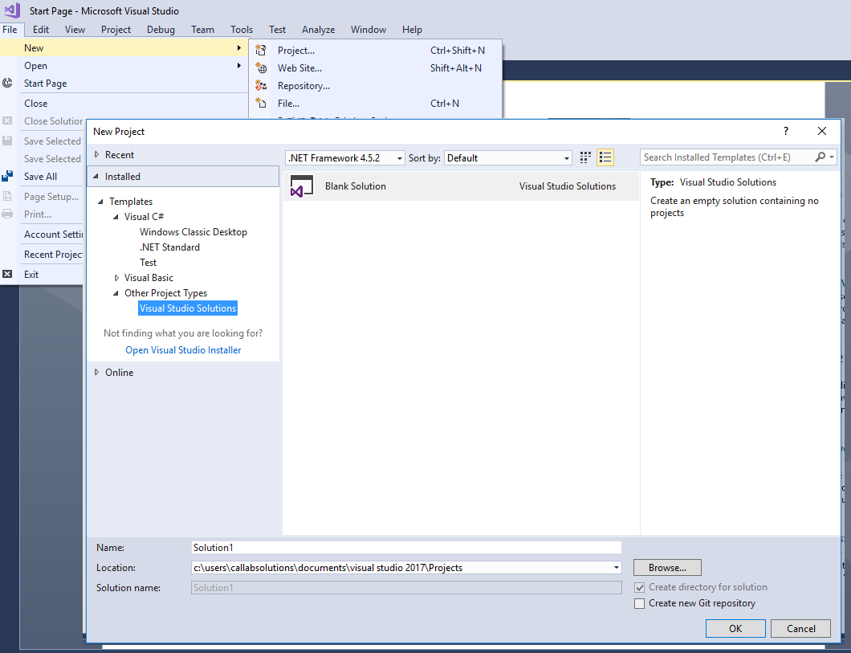
Visual Studio Setup
Select New Project
Select Other Project Types
Select Visual Studio Solutions
Navigate to C:\_Programming\MS.NET\ SASO\<Company>\Testcode
Project Name SampleTestingSolution
Set Framework to 4.0

Slide 8
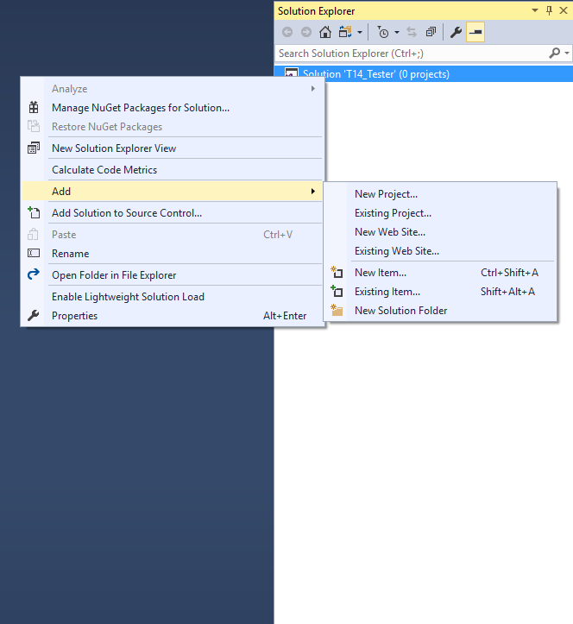
Solution Setup
Select Add
Existing Projects in C:\_Programming\MS.NET\SASO
..\CLS\TestCode\TestPointSelector TestPointSelector.vbproj
..\CLS\Drivers\Fluke_5720A Fluke_57x0A.vbproj
..\CLS\Drivers\UUT_Command UUT_TpControl.vbproj

Slide 9
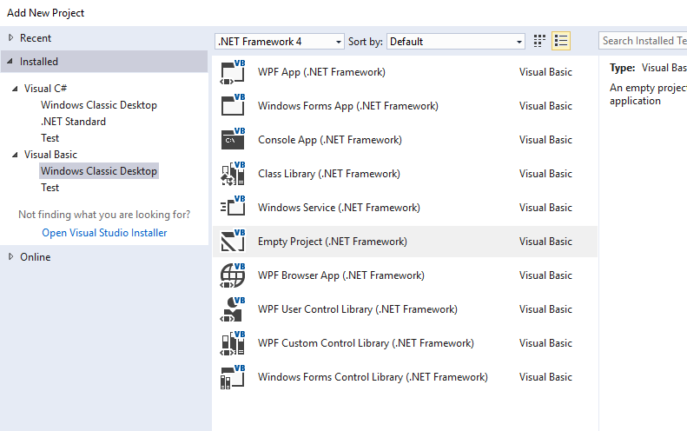
Solution Setup
Select Add
New Project Projects
.NET Framework 4
Visual Basic Windows Classic Desktop
Empty Project(.NET Framework)
Name: SampleTestingProject
in: C:\_Programming\MS.NET\SASO\<Company>\TestCode\SampleTestingSolution

Slide 10
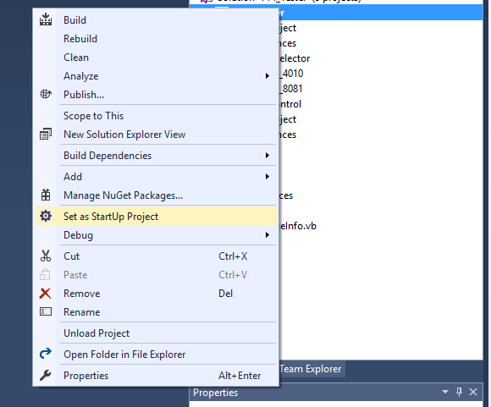
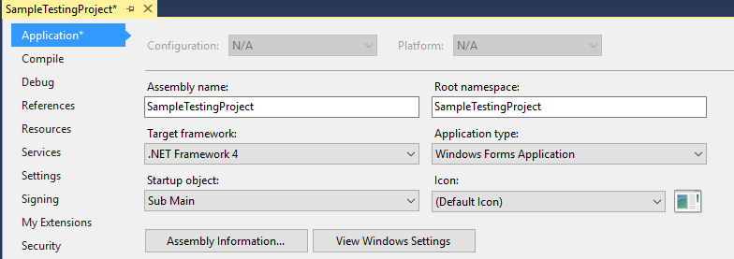
Project Setup
SampleTestingProject Set as Startup Project
Startup Object Sub Main

Slide 11
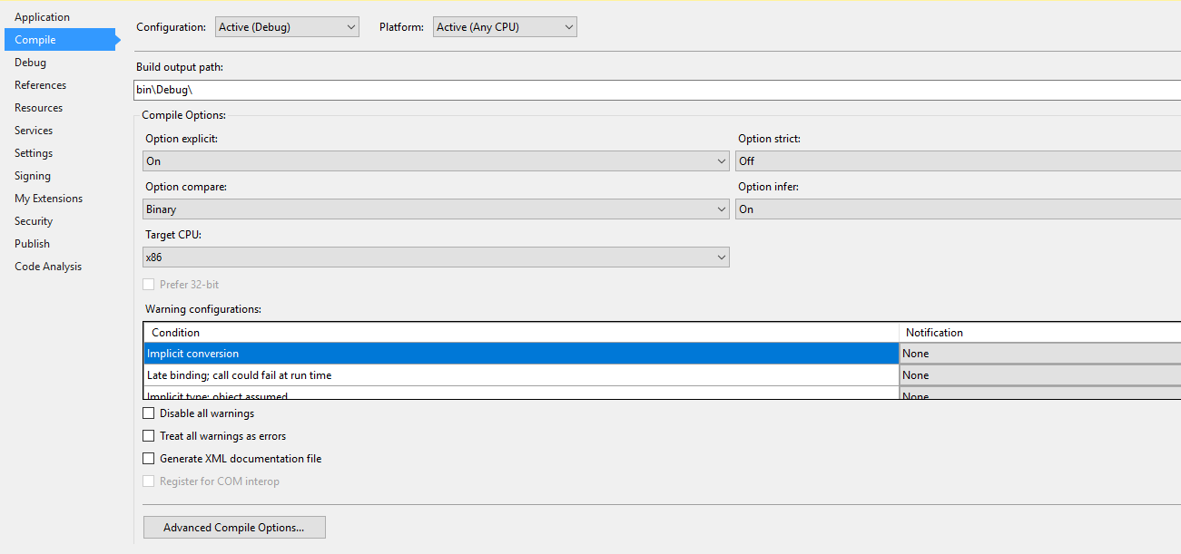
Project Setup
Project Must be set to x86

Slide 12
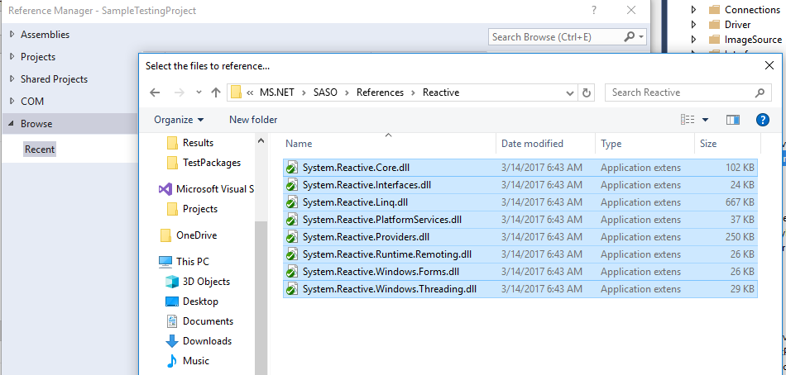
Project Setup
Add References from C:\_Programming\MS.NET\SASO\References MetrologyNet.dll MessageService.dll
Add .Net Reactive References from C:\_Programming\MS.NET\SASO\References\Reactive

Slide 13
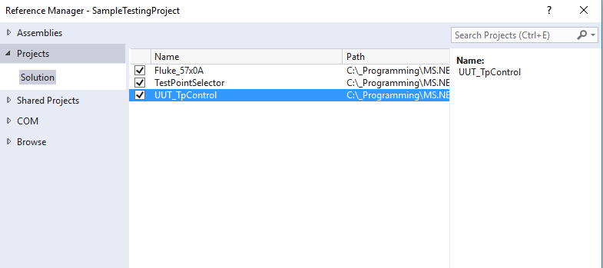
Project Setup
Add Project References Fluke_57x0A TestPointSelector UUT_TpControl

Slide 14
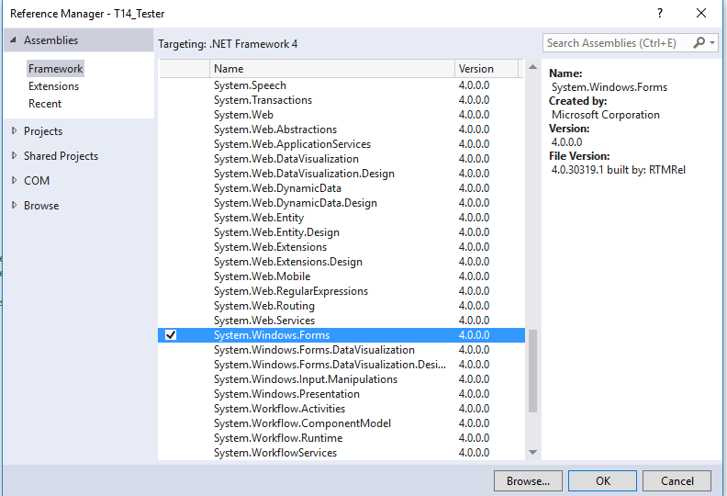
Project Setup
Add Forms References System.Windows.Forms

Slide 15
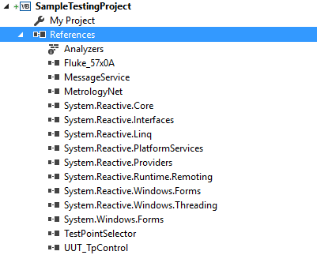
Spread Sheet Review
References should look like this

Slide 16
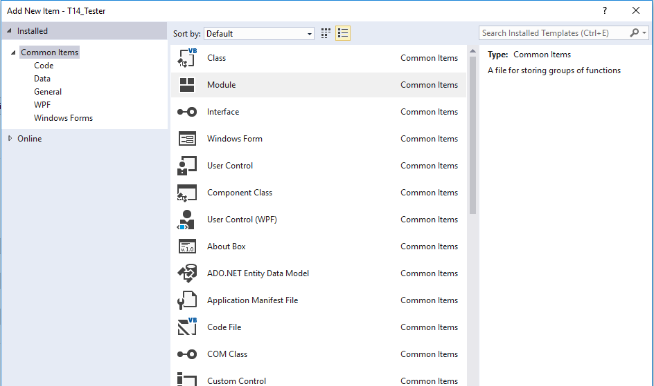
Add AppMain
Add new Item to Project
Module
Named AppMain.vb

Slide 17
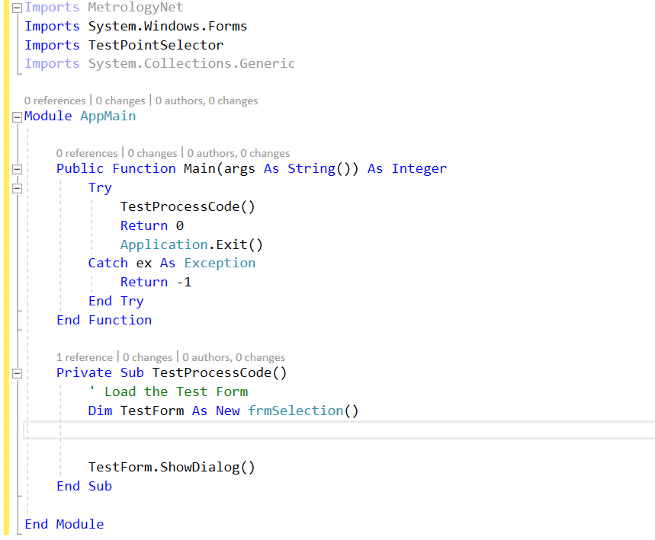
AppMain Code

Slide 18
Add Fluke57x0_Config
Add new Item to Project
Module
Named Fluke57x0_Config.vb

Slide 19
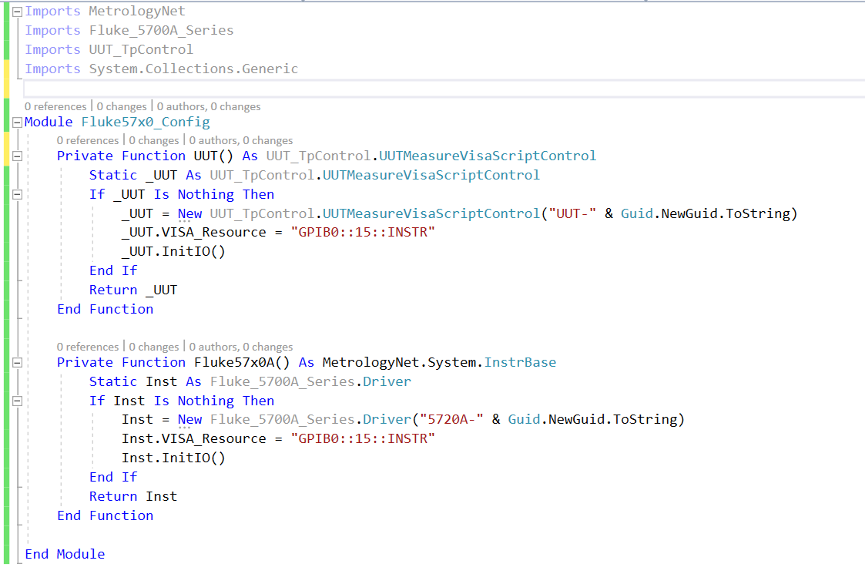
Add Code

Slide 20
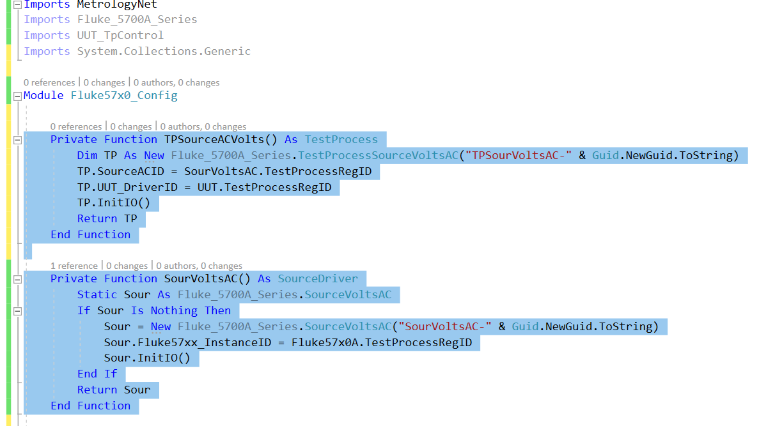
Add Code

Slide 21
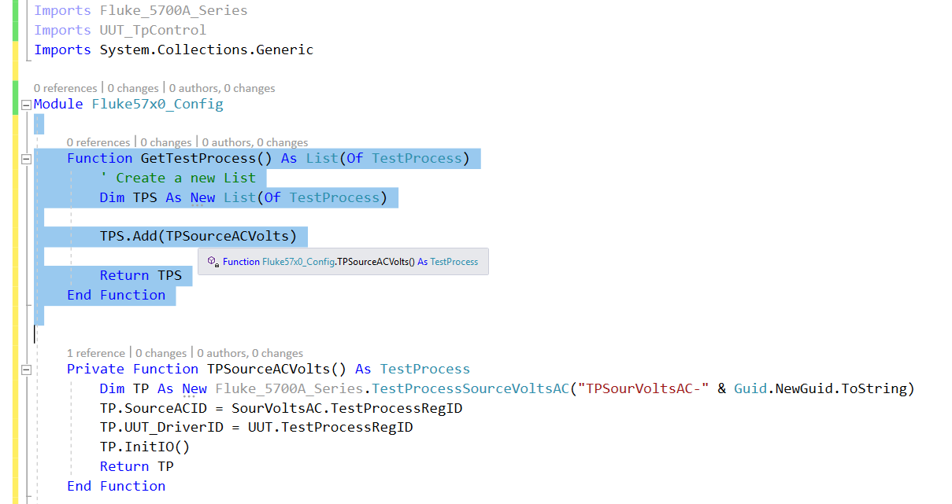
Add Code

Slide 22
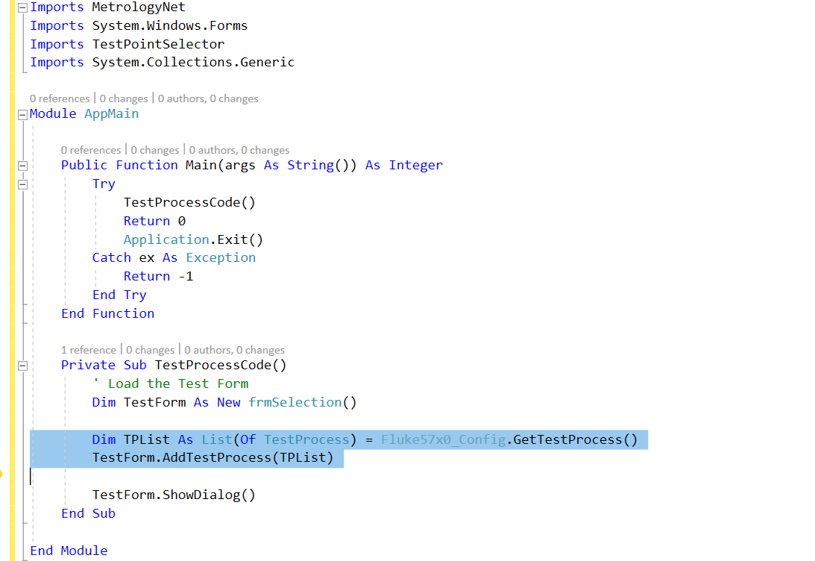
AppMain Code

Slide 23
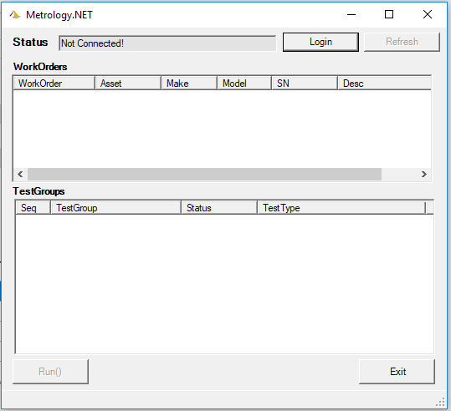
Code Review
Run the Program
Show Login Form
Show Test Selection Form
Show Run Button
Show Break Points and Stepping

Slide 24
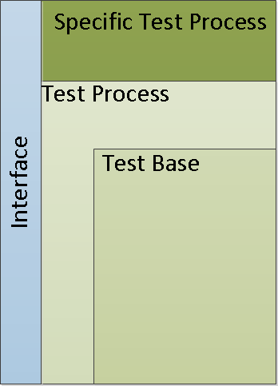
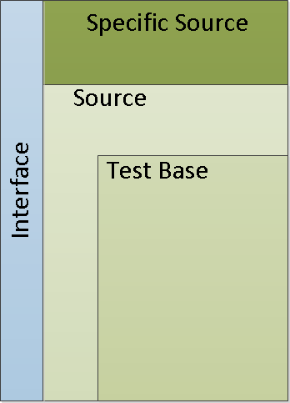
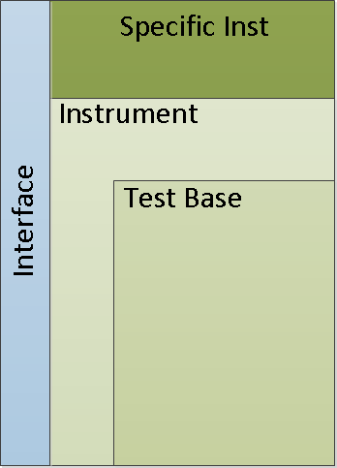
Driver Overview
I/O
Test Process → Source → Instrument
UUTs are Interchangeable

Slide 25
Learning Objectives
OOP (Object Oriented Programming) in VB.NET
Metrology.NET Driver Structure
Testing Threaded Applications
Setting up a testing solution in Visual Studio

Slide 26
Questions? / Comments
Michael L. Schwartz
Cal Lab Solutions
mschwartz@callabsolutions.com

