Slide 1
Metrology Automation Lunch & Learn Metrology.NET® Station Agent
Michael L. Schwartz

Slide 2
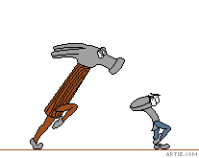
Learning Objectives
NCSLI – MII Taxonomy
OOP (Object Oriented Programming) in VB.NET
.NET Reflection
Properties and Attributes
Testing & Running Metrology.NET

Slide 3
About Cal Lab Solutions
Veteran owned business, ex-military metrologist
Core business is software
Metrology consulting
Efficiencies through automation
Turn-key system
Focus on finding the right solution for the customer
Created Metrology.NET® in 2015
World’s largest MET/CAL® procedure library
PS-Cal® power sensor calibration solution - Now Tegam’s Product
C# web-based asset management system
Acquired Cal Lab Magazine in 2011

Slide 4
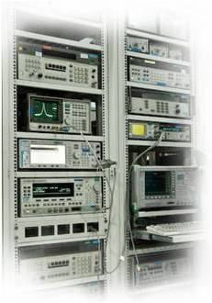
Business is about Efficiency?
Better
Cheaper
Faster
That doesn’t mean less accurate

Slide 5
Problem Statement
A Metrology.NET Station Agent is able to run multiple calibrations at the same time on a single GPIB card. This makes the setup a little more complex than just setting the GPIB address.

Slide 6
Testing Requirements
Setting up a Test Station to Test DMM’s with the Fluke 5730A
Test Case UUT HP 34401A
HP 34401A Test Package – Already Created
VISA Script for AC Voltage – Already Created
Standards Used
Fluke 5730A
Agilent 33250A
4-Wire Short
Software Needed
StationAgent.exe
Metrologynet.dll
MessageService.dll
Microsoft .NET reactive libraries
Drivers
Fluke_5700A_Series.dll
Agilent_33250A.dll
UUT_TPController.dll
UUT_DMM.dll

Slide 7
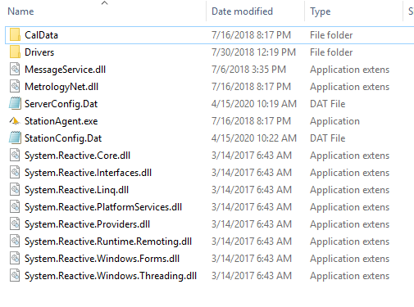
Station Agent Setup
Station Agent Setup
Copy the Files to C:\_StationAgent
** Deleting Driver Files not being used makes the configuration easier.

Slide 8
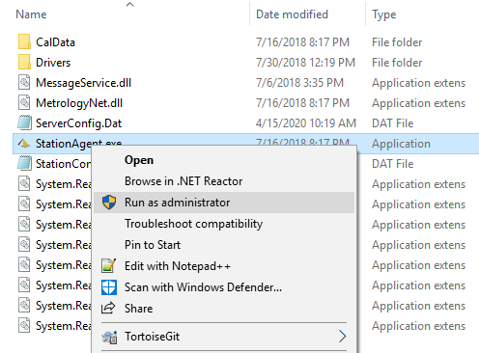
Station Agent Setup
Right Click the StationAgent.exe
Run as administrator to setup

Slide 9
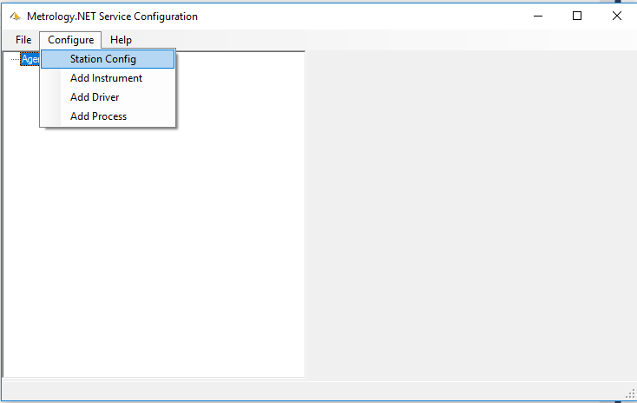
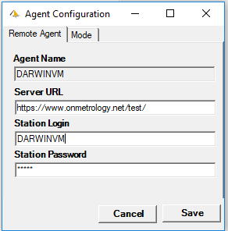
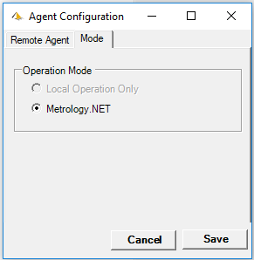
Station Agent Setup
Click Configure → Station Config
Set URL / Login & Password Set Mode to Metrology.NET

Slide 10
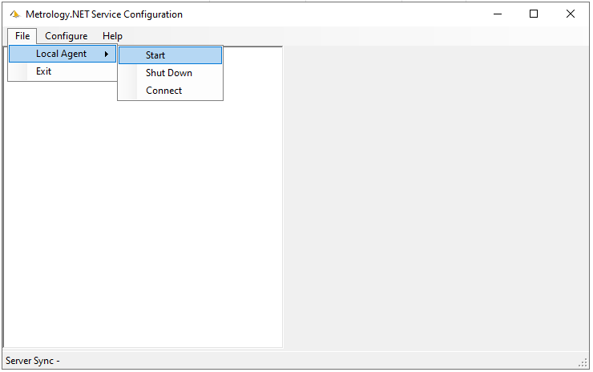
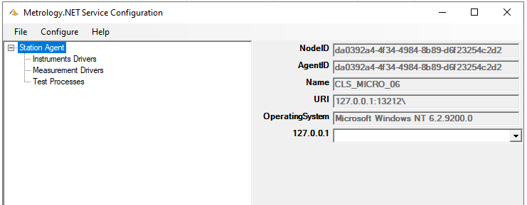
Station Agent Setup
Click File → Local Agent → Start
You may need to open the Firewall Localhost Port 13212

Slide 11
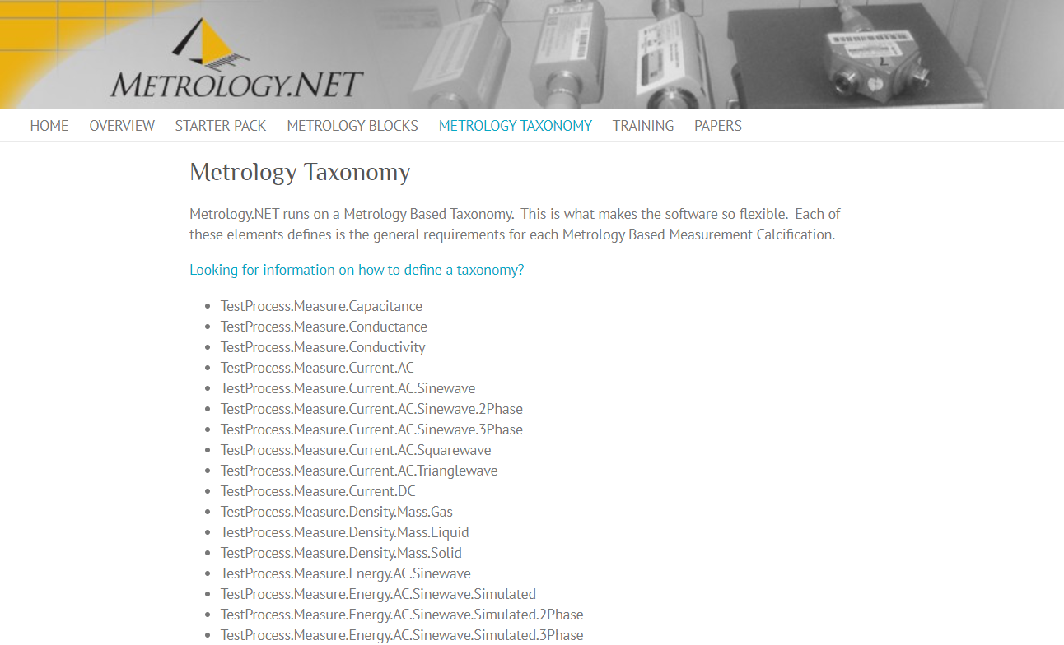
Metrology MII Taxonomy
URL http://miiknowledge.wikidot.com/start https://www.metrology.net/home/metrology-taxonomy/

Slide 12
Station Agent Setup
Setting up a Test Station to Test DMMs with the Fluke 5730A
Test Process
Fluke 5730A
TestProcess.Source.Current.AC.Sinewave TestProcess.Source.Current.DC TestProcess.Source.Resistance TestProcess.Source.Voltage.AC.Sinewave TestProcess.Source.Voltage.DC Agilent 33250A
TestProcess.Source.Frequency UUT_DMM
TestProcess.Source.Short.DMM
UUT
UUT_TpController.UUTMeasureVisaScriptControl

Slide 13
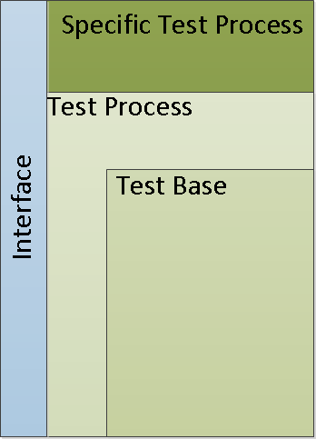
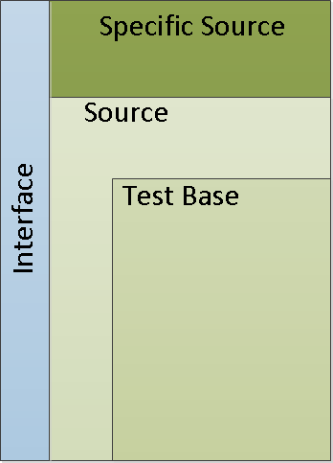
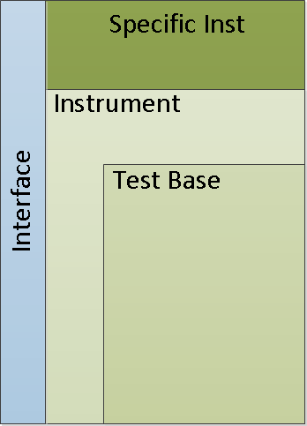
Driver Overview
I/O
Test Process → Source → Instrument
UUTs are Interchangeable

Slide 14
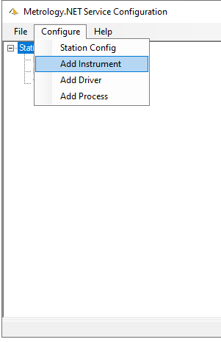
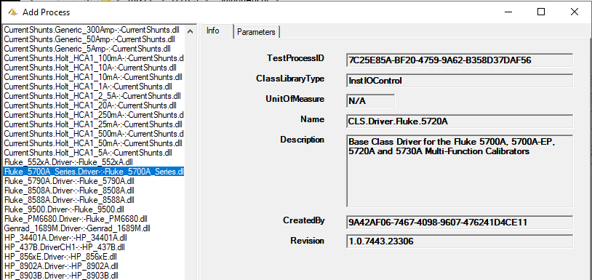
Station Agent Setup
Click Configure → Add Instrument
Scroll Down to the Fluke_5700A_Series
Press Add

Slide 15
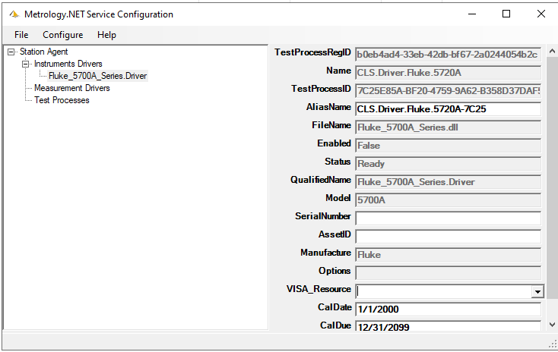
Station Agent Setup
Expand the Instrument Drivers
Select Fluke_5700A_Series.Driver
Set the Required information

Slide 16
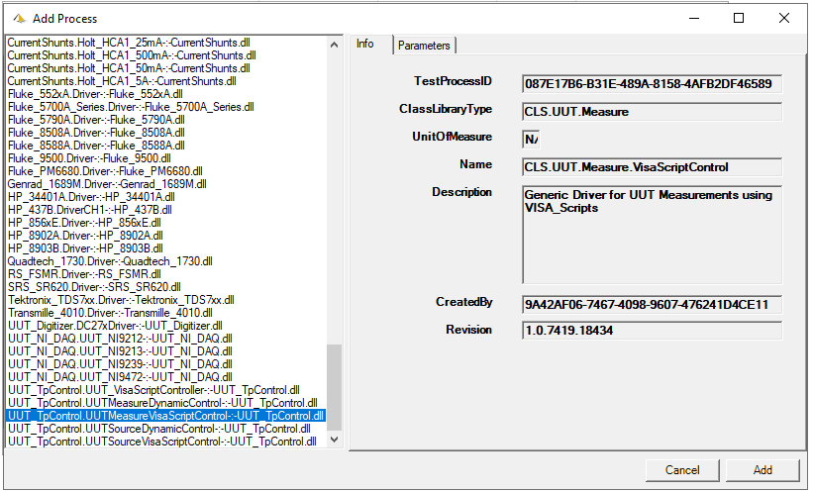
Station Agent Setup
Repeat for the Agilent_33250A.Driver and UUT_TpControl.UUTMeasure.VisaScriptControl

Slide 17
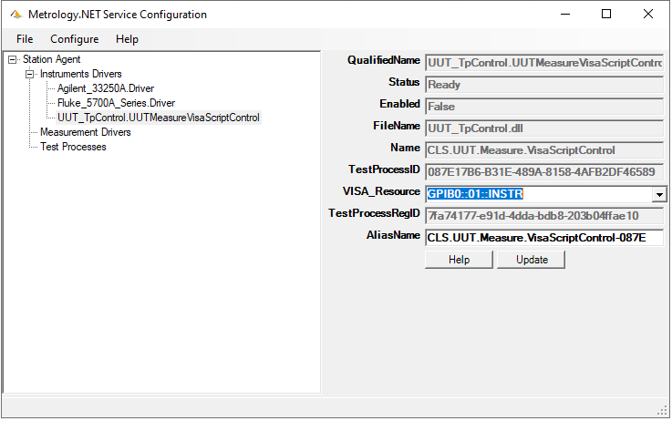
Station Agent Setup
Station Configuration should look something like this.

Slide 18
Driver Overview
I/O
Test Process → Source → Instrument
UUTs are Interchangeable

Slide 19
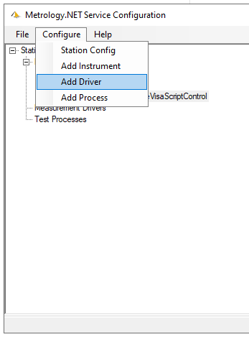
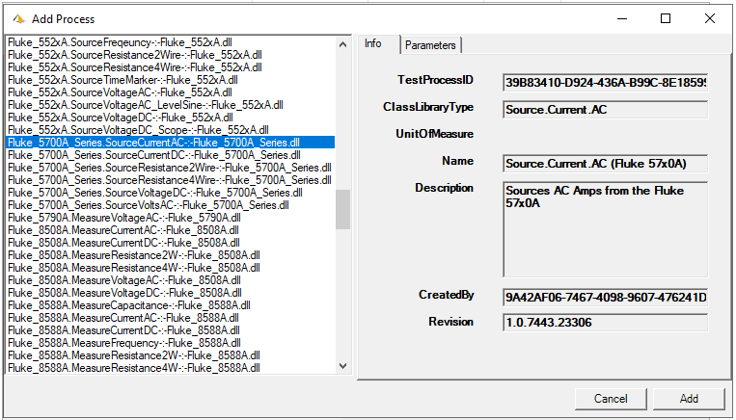
Station Agent Setup
Click Configure → Add Driver
Scroll Down to the Fluke_5700A…SourceCurrentAC
Press Add
cc

Slide 20
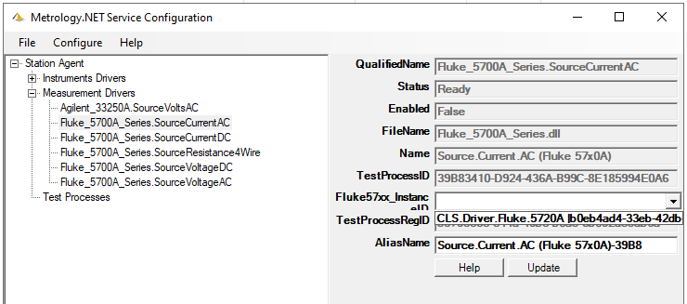
Station Agent Setup
Repeat for the Following:
Agilent_33250A.SourceVoltageAC Fluke_5700A_Series.SourceCurrentDC Fluke_5700A_Series.SourceCurrentAC
Fluke_5700A_Series.Resistance4Wire
Fluke_5700A_Series.VoltageAC
Fluke_5700A_Series.VoltageDC

Slide 21
Driver Overview
I/O
Test Process → Source → Instrument
UUTs are Interchangeable

Slide 22
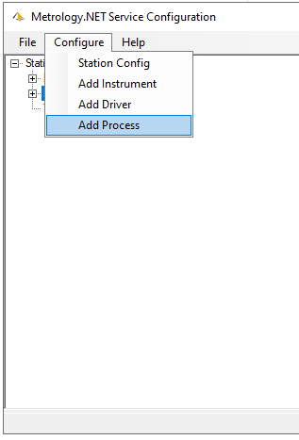
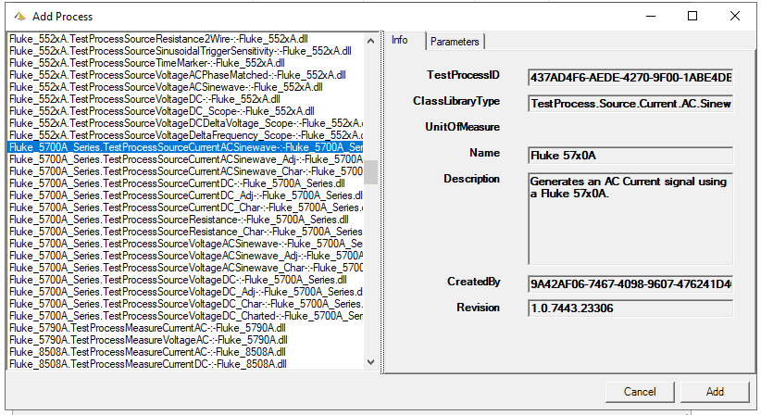
Station Agent Setup
Click Configure → Add Test Process
Scroll Down to Fluke_5700A…SourceCurrentACSinewave
Press Add

Slide 23
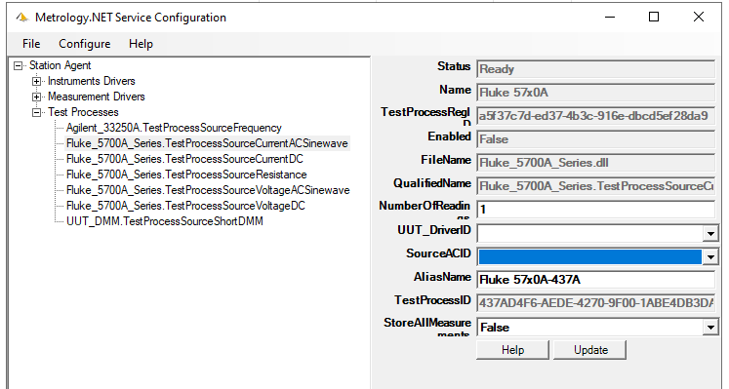
Station Agent Setup
Repeat for the following:
Agilent_33250A.TestProcessSourceFrequency Fluke_5700A_Series.TestProcessSourceCurrentDC Fluke_5700A_Series.TestProcessSourceCurrentAC
Fluke_5700A_Series.TestProcessResistance
Fluke_5700A_Series.TestProcessVoltageACSinewave
Fluke_5700A_Series.TestProcessVoltageDC
UUT_DMM.TestProcessSourceShortDMM

Slide 24
Driver Overview
I/O
Test Process → Source → Instrument
UUTs are Interchangeable

Slide 25
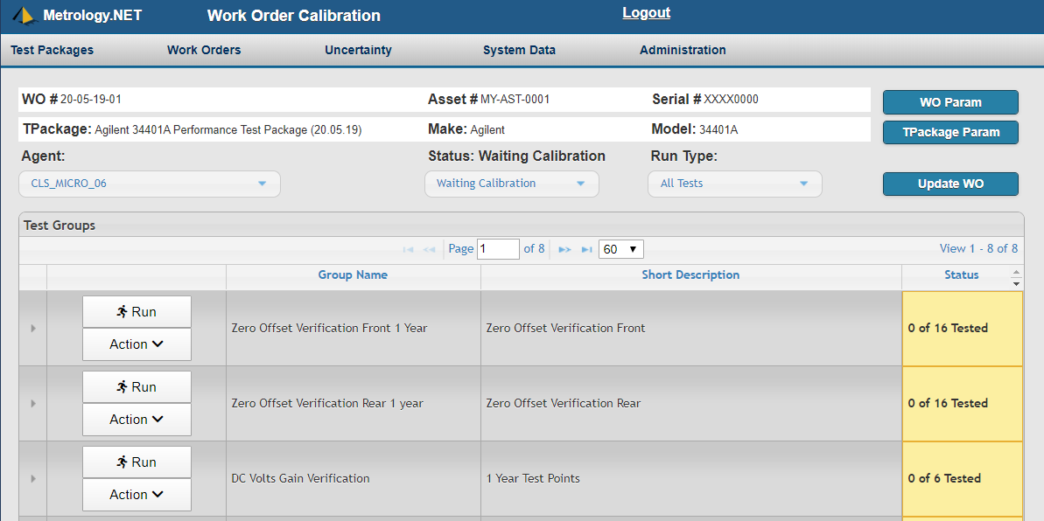
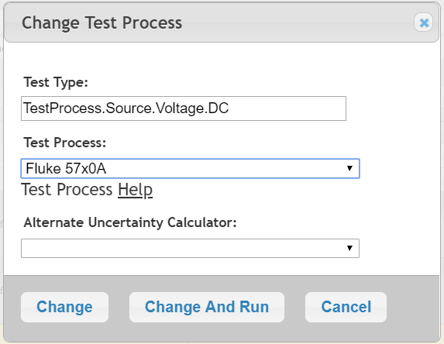
Running the Automation

Slide 26
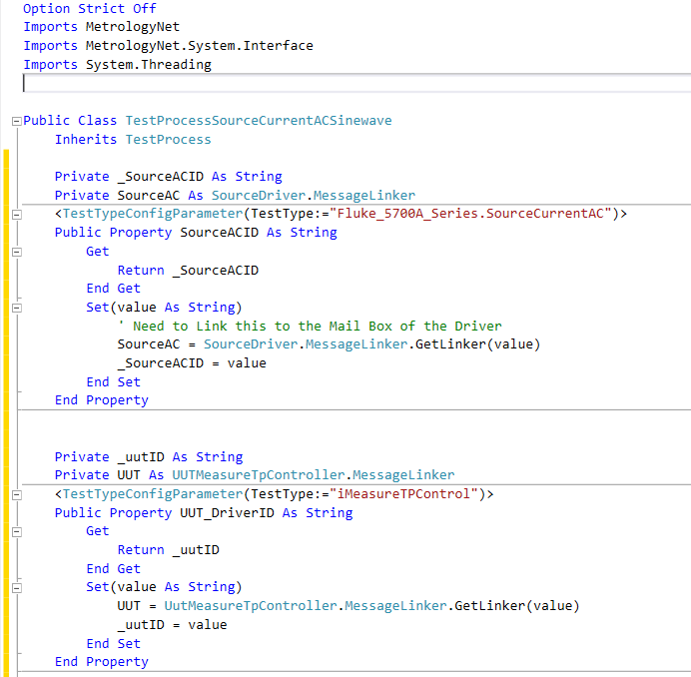
Under the Hood

Slide 27
Driver Overview
I/O
Test Process → Source → Instrument
Power of OOP
UUTs are Interchangeable

Slide 28
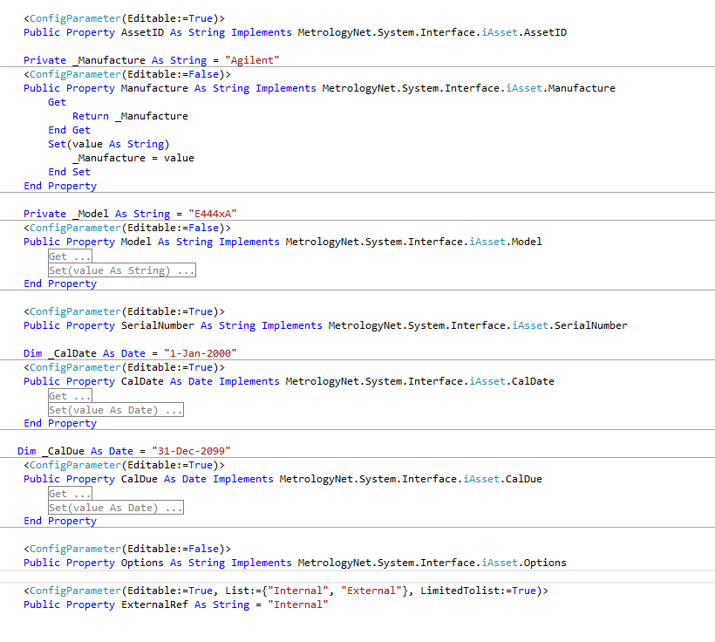
Under the Hood
UI Auto Writes
Editable
Lists
LimitedToList
Etc…

Slide 29
Learning Objectives
NCSLI – MII Taxonomy
OOP (Object Oriented Programming) in VB.NET
.NET Reflection
Properties and Attributes
Testing & Running Metrology.NET

Slide 30
Questions? / Comments
Michael L. Schwartz
Cal Lab Solutions
mschwartz@callabsolutions.com

Slide 31
Station Agent Setup
Click Configure → Add Instrument
Scroll Down to the Fluke_5700A_Series
Press Add

