Slide 1
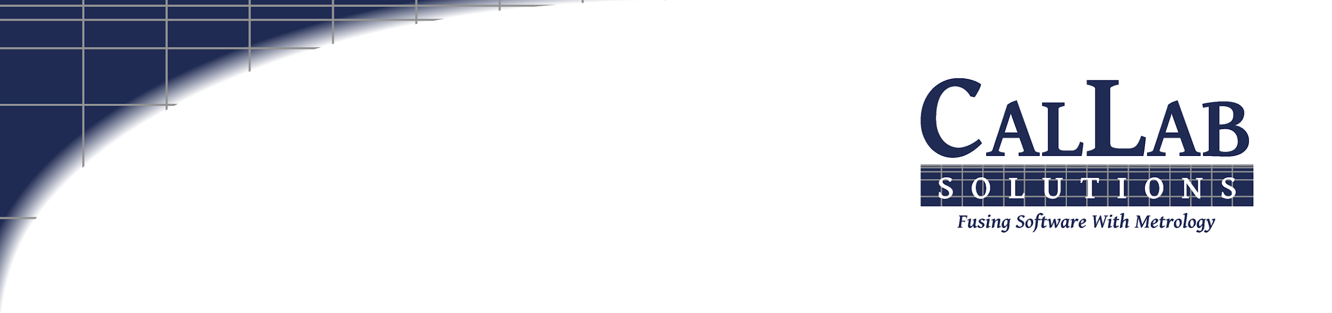
Metrology Automation
Lunch & Learn
Metrology.NET® Drivers
Michael L. Schwartz

Slide 2

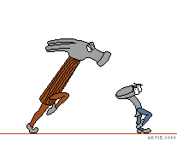
Learning Objectives
OOP (Object Oriented Programming) in VB.NET
        Threaded Automation & Actor Paradigm
        Intro to Metrology Taxonomy
        Basic 17025 Uncertainties
        Customizable Uncertainties without Code Changes

Slide 3



About Cal Lab Solutions
Veteran owned business, ex-military metrologist
Core business is software
  Metrology consulting
  Efficiencies through automation
  Turn-key system
Focus on finding the right solution for the customer
  Created Metrology.NET® in 2015
  World’s largest MET/CAL® procedure library
  PS-Cal® power sensor calibration solution - Now Tegam’s Product
  C# web-based asset management system
Acquired Cal Lab Magazine in 2011

Slide 4
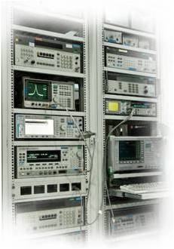
Business is about Efficiency?
Better
Cheaper
Faster
That doesn’t mean less accurate

Slide 5
Problem Statement
Cal Lab Solutions writes custom software for companies around the world.
We needed more powerful tools for automating calibration
We wanted to create Standard Metrology Process
            Tie Metrology Process to Uncertainty Calculation
            Reuse the Process & Uncertainties with no Code Change

Slide 6
Overview
Build a Metrology Software Solution that meets the needs from NMI to production.
Each level has different Requirements
NMIs are pushing the limits
small nuances of the measurement
Production wants
Turn-Key Flexible Standards
Metrology.NET covers the
Entire Pyramid

Slide 7
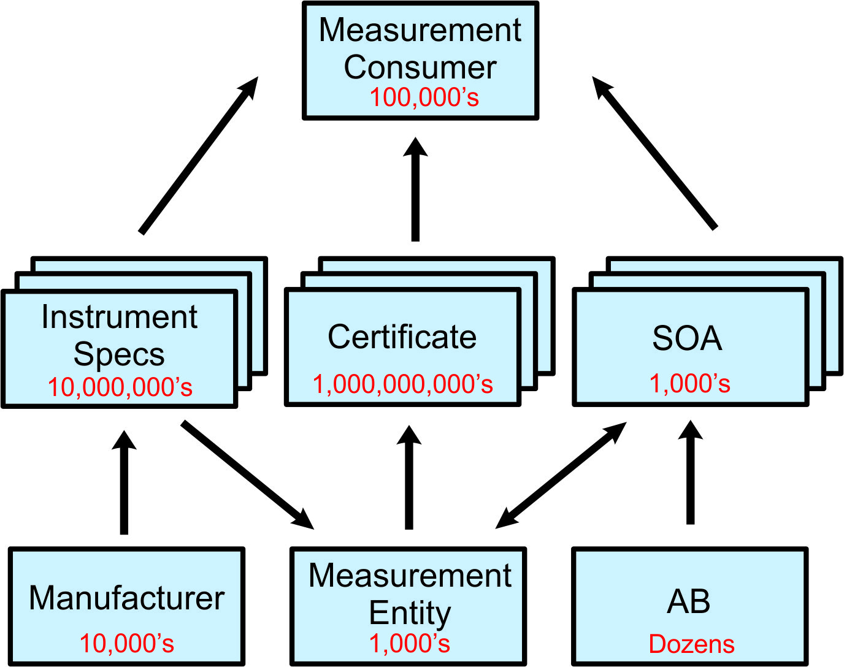
Metrology Taxonomy
Taxonomy
Is the Glue
that Binds
It all Together
NCSLI 141 – MII & Automation
Working on a Metrology Taxonomy
We meet EVERY Monday
2:00 pm MST

Slide 8
Metrology Taxonomy
The industry needs to build a Taxonomy of Measurements so we can index, catalog, and easily share measurement related data.
AC.Sine
Source.Amps.AC.Sine
(Implementation)
Amps
DC
Source.Amps.DC
(Implementation)
Source
AC.Sine
Source.Volts.AC.Sine
(Implementation)
Volts
root
DC
Source.Volts.DC
(Implementation)
AC.Sine
Measure.Amps.AC.Sine
(Implementation)
Amps
DC
Measure.Amps.DC
(Implementation)
Measure
AC.Sine
Measure.Volts.AC.Sine
(Implementation)
Volts
DC
Measure.Volts.DC
(Implementation)

Slide 9
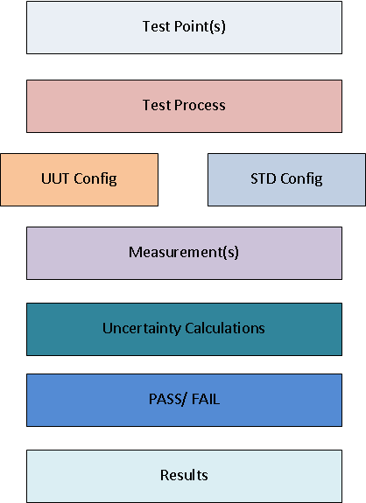

Metrology.NET Overview
Test points are the key in Metrology.NET®
Core Data (Nominal, Limits, Unit of Measure)
Metadata – Data about the data
  Better defines a test point
  Describes test point details
Metadata in Name Values Pairs
Infinitely expandable
AC Voltage example
  Volts = 10
  Frequency = 10e3
  Range= 10
  Impedance= 1e6

Slide 10
Metrology.NET Overview
Industry Standard
Any Software Platform that can
Authenticate with
Metrology.NET Server
Download TestPoints
Upload TestResults
… is Metrology.NET Compliant!
VB.NET, C#.NET
LabView
MET/CAL®
HP VEE
JAVA
KISS

Slide 11
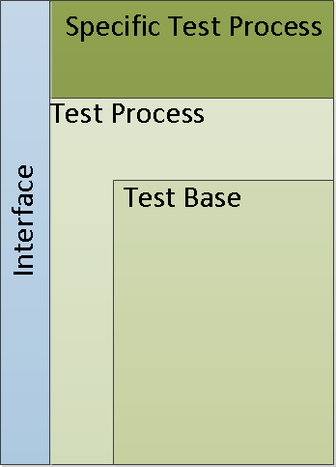
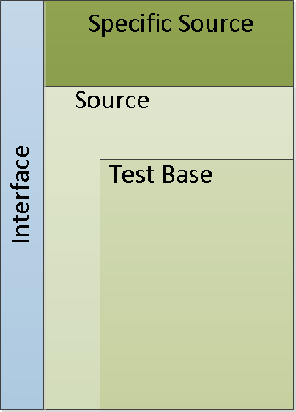

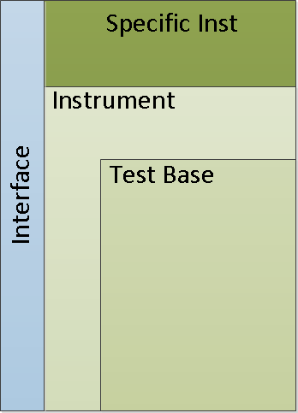
Metrology.NET Overview
20 % Specific to Process
80% Part of the System
I/O
Programming Standard
Custom Code
Type Added Code
Base Added Code – Shared by All
I/O Text Messages

Slide 12


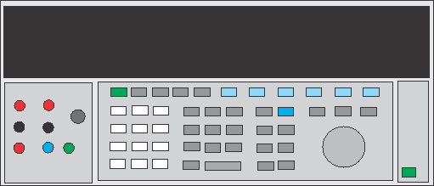
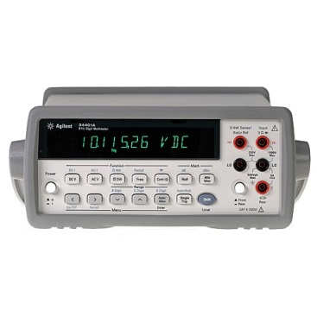
Metrology.NET Way
Test Process
Source.Volts.AC (Fluke 5720A)
Run()
STD.Reset
UUT.Reset
For Each TestPoint
UUT.Setup
STD.Setup
STD.Enable
UUT.Measure
TestPoint.SaveData
STD.Disable
Next
VISA Script
---------------------------------
Section= Reset
*RST
*OPC?
---------------------------------
Section= Setup
CONF:VOLT:AC
SENS:VOLT:AC:RANG [Range]
SENS:VOLT:AC:BAND [Filter]
*OPC?
---------------------------------
Section= Measure
READ?
READ?
---------------------------------
RESULTS!

Slide 13
Code Review
Code Review
Fluke 5720A AC Volts Test Process Source
Fluke Source AC Volts
Unc Calc
Fluke 5720A Driver
UI Options
Fluke 5720A AC Volts Test Process – Characterized
Characterization Object
Unc Calc
Fluke 5520A AC Volts Test Process Source
Transmille 4010 AC Volts Test Process
Test Point Filters

Slide 14
Uncertainty Override
Post Process Uncertainties
The Value is passed to the Calculator
AC Voltage example:
Volts = 10
Frequency = 10e3
Range = 10
Impedance = 1e6
Calibrator = 5720A
Interval = 1 Year
Resolution = 1e7
Repeatability = 1.456e-7
Quality Magazine
Oct 2015, Volume 54/Number 10

Slide 15
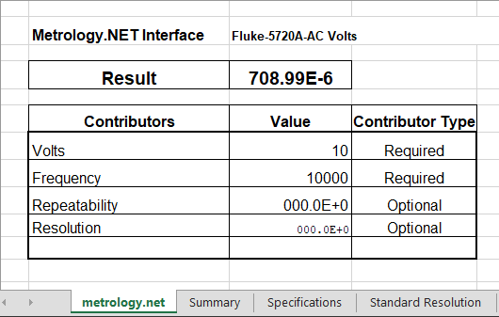
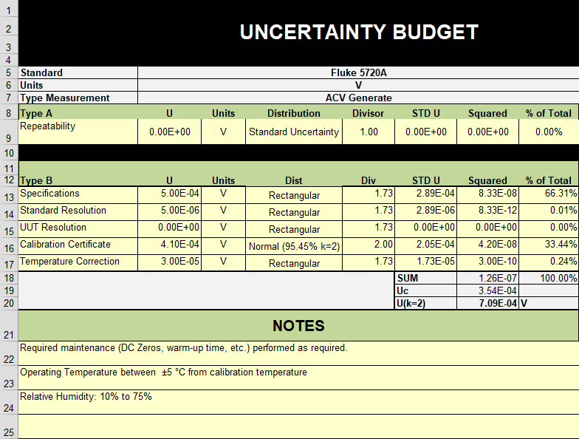
Uncertainty Override

Slide 16
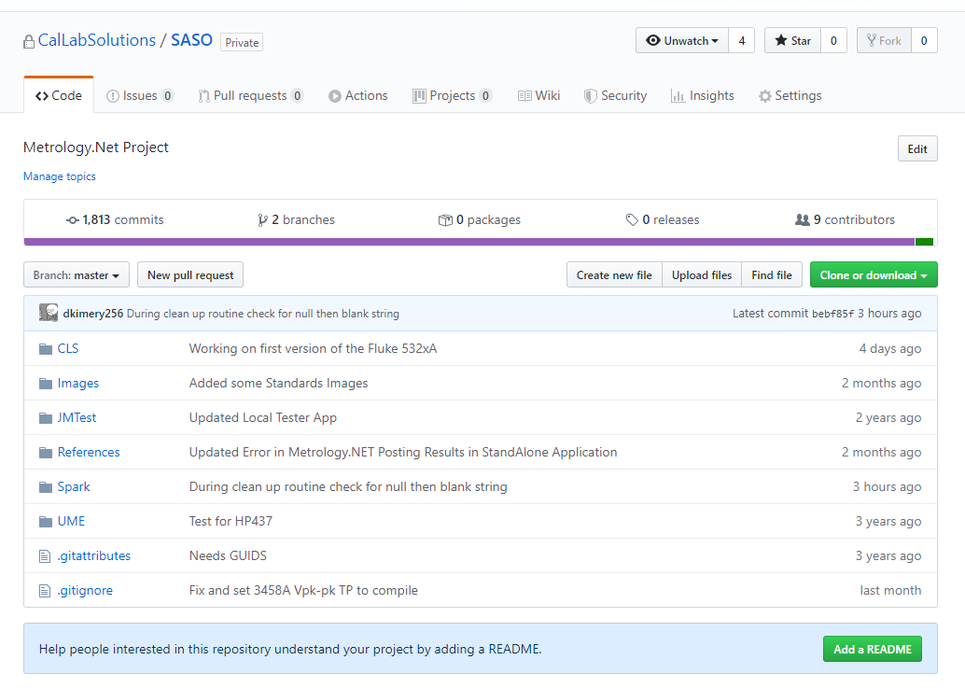
Free Example Code
To all Metrology.NET Users
https://github.com/CalLabSolutions/SASO

Slide 17
Learning Objectives
OOP (Object Oriented Programming) in VB.NET
        Threaded Automation & Actor Paradigm
        Intro to Metrology Taxonomy
        Basic 17025 Uncertainties
        Customizable Uncertainties without Code Changes

Slide 18

Questions? / Comments
Michael L. Schwartz
Cal Lab Solutions
mschwartz@callabsolutions.com

