Slide 1
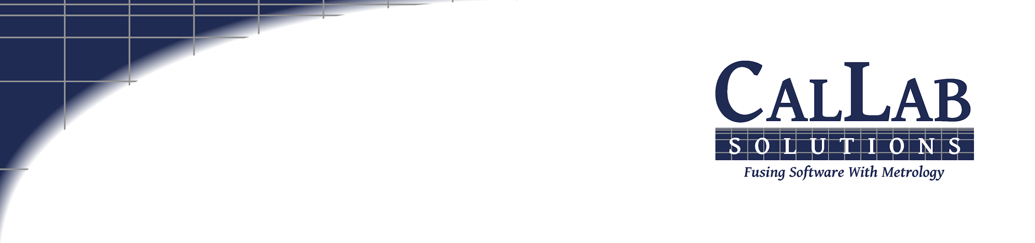
Metrology Automation
Lunch & Learn
Metrology.NET® Calibration Drift & Control Charts
Michael L. Schwartz

Slide 2
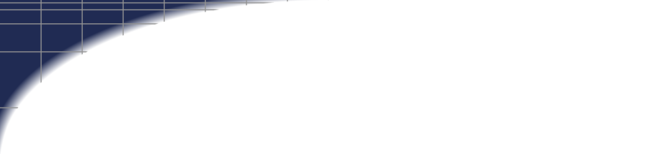
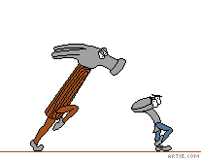
Learning Objectives
OOP (Object Oriented Programming) in VB.NET
        Control Charts and Calibration Drift
        Basic ISO/IEC 17025 Uncertainties
        Customizable Uncertainties without Code Changes

Slide 3



About Cal Lab Solutions
Veteran owned business, ex-military metrologist
Core business is software
  Metrology consulting
  Efficiencies through automation
  Turn-key system
Focus on finding the right solution for the customer
  Created Metrology.NET® in 2015
  World’s largest MET/CAL® procedure library
  PS-Cal® power sensor calibration solution - Now Tegam’s Product
  C# web-based asset management system
Acquired Cal Lab Magazine in 2011

Slide 4
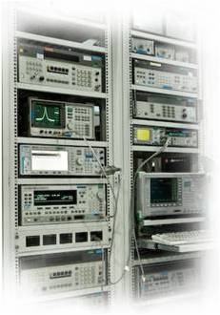
Business is about Efficiency?
Better
Cheaper
Faster
That doesn’t mean less accurate

Slide 5
Problem Statement
High Accuracy low uncertainty standards like resistors and 10 V cell’s values drift over time. We need best numbers during a calibration.
Most labs used Excel for this task
But there is a high maintenance cost
Metrology software should have this built in
Must calculate predicted value
            Must calculate predicted uncertainty
            Maintenance costs should be minimal

Slide 6
Math Review
BIG THANKS TO
Jeff Gust – For Training on this at NCSLI
Robb Thomas – For teaching me
1 Ohm Fluke 742-1
6 calibrations over 5 years
Each Calibration has
Value
Uncertainty

Slide 7
Spread Sheet Review
Calibration Data Input
6 Calibrations with Date Value & Uncertainty
Calibration Data Output
6 Predicted Values & Uncertainty
Future Date with Value & Uncertainty
Graphs
Control Chart
Predicted Value with Slopes
Uncertainty Recreation Data
Cal Dates are converted to Days
Problems
Layout for software integration
Every time you add more data you have to rebuild the sheet

Slide 8
Code Review
Public Class CalPoint
Public Property vDate As Date
Public Property Days As Double
Public Property CalValue As Double
Public Property Unc As Double
Shared Function NewDataPoint(ByVal vDate As Date, ByVal Value As Double, _
ByVal Unc As Double) As CalPoint
Dim NewData As New CalPoint
Dim RefDate As Date = New Date(1900, 1, 1)
Dim days As Double = vDate.Subtract(RefDate).Days
NewData.vDate = vDate
NewData.Days = days
NewData.CalValue = Value
NewData.Unc = Unc
Return NewData
End Function
End Class

Slide 9
Code Review
Public Class ControlChart
Friend myData As New List(Of ControlChart.CalPoint)
Public Function CalcSlope() As Double
Try
Dim Data As IEnumerable(Of CalPoint) = Me.myData
Dim averageX As Double = Data.Average(Function(d) d.Days)
Dim averageY As Double = Data.Average(Function(d) d.CalValue)
Return Data.Sum(Function(d) (d.Days - averageX) * (d.CalValue - averageY)) / _
Data.Sum(Function(d) Math.Pow(d.Days - averageX, 2))
Catch ex As Exception
ErrorLog.Log(ex)
Return "39e39"
End Try
End Function
Public Function CalcIntercept() As Double
Try
Dim Data As IEnumerable(Of CalPoint) = Me.myData
Dim slope As Double = CalcSlope()
Return Data.Average(Function(d) d.CalValue) - slope * Data.Average(Function(d) d.Days)
Catch ex As Exception
ErrorLog.Log(ex)
Return "39e39"
End Try
End Function

Slide 10
Code Review
Public Function PerdictedValue(ByVal dDate As Date) As Double
Try
Dim Data As IEnumerable(Of CalPoint) = Me.myData
Dim RefDate As Date = New Date(1900, 1, 1)
Dim days As Double = dDate.Subtract(RefDate).Days
Return days * CalcSlope() + CalcIntercept()
Catch ex As Exception
ErrorLog.Log(ex)
Return "39e39"
End Try
End Function

Slide 11
Code Review
Public Function PerdictedUnc(ByVal dDate As Date) As Double
Try
Dim Data As IEnumerable(Of CalPoint) = Me.myData
Dim LastCal As Date = Data.Max(Function(d) d.vDate)
Dim FirstCal As Date = Data.Min(Function(d) d.vDate)
Dim StartDays As Double = Data.Min(Function(d) d.Days)
Dim SumSqrVal As Double
Dim SumSqrDay As Double
Dim SumDay As Double
'Get all the Values
For Each DataPoint In Me.myData
SumSqrVal = SumSqrVal + (DataPoint.CalValue - PerdictedValue(DataPoint.vDate)) ^ 2
SumDay = SumDay + (DataPoint.Days - StartDays)
SumSqrDay = SumSqrDay + ((DataPoint.Days - StartDays) ^ 2)
Next
Dim StdErr = Math.Sqrt(SumSqrVal) / 2
Dim Sxx = SumSqrDay - ((SumDay ^ 2) / (Me.myData.Count))
Dim MeanCalTime = SumDay / Me.myData.Count
Dim DaysFromLastcal = dDate.Subtract(LastCal).Days
Dim CalDays As Double = LastCal.Subtract(FirstCal).Days
Dim Value As Double = StdErr * (Math.Sqrt(1 + (1 / (Me.myData.Count)) + _
((((CalDays + DaysFromLastcal) - MeanCalTime) ^ 2) / Sxx)))
Return Value
Catch ex As Exception
ErrorLog.Log(ex)
Return "39e39"
End Try
End Function

Slide 12
Code Review
Dim Chart As New Tools.ControlChart
''5/8/20011.000013 0.4
Chart.AddCalPoint(Tools.ControlChart.CalPoint.NewDataPoint("5/8/2001", "1.000013", "0.4e-6"))
''11/9/20011.00001410.4
Chart.AddCalPoint(Tools.ControlChart.CalPoint.NewDataPoint("11/9/2001", "1.0000141", "0.4e-6"))
''5/15/20021.00001490.4
Chart.AddCalPoint(Tools.ControlChart.CalPoint.NewDataPoint("5/15/2002", "1.0000149", "0.4e-6"))
''11/19/20021.00001690.4
Chart.AddCalPoint(Tools.ControlChart.CalPoint.NewDataPoint("11/19/2002", "1.0000169", "0.4e-6"))
''7/3/20031.00001740.4
Chart.AddCalPoint(Tools.ControlChart.CalPoint.NewDataPoint("7/3/2003", "1.0000174", "0.4e-6"))
''1/6/20041.00001850.4
Chart.AddCalPoint(Tools.ControlChart.CalPoint.NewDataPoint("1/6/2004", "1.0000185", "0.4e-6"))
Dim Slope As Double = Chart.CalcSlope()
Dim intercept As Double = Chart.CalcIntercept()
Dim PVal As Double = Chart.PredictedValue("1/6/2005")
Dim Punc As Double = Chart.PredictedUnc("1/6/2005")

Slide 13
Code Review
Run the Program

Slide 14
Learning Objectives
OOP (Object Oriented Programming) in VB.NET
        Control Charts and Calibration Drift
        Basic ISO/IEC 17025 Uncertainties
        Customizable Uncertainties without Code Changes

Slide 15

Questions? / Comments
Michael L. Schwartz
Cal Lab Solutions
mschwartz@callabsolutions.com

